Slide 1
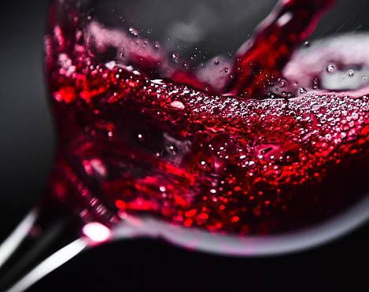
Red Wine Classification
Matthew Tafazoli

Slide 2
Dataset Overview
This datasets is related to red variants of the Portuguese "Vinho Verde" wine
For more details, consult the reference [Cortez et al., 2009]
The dataset contains the following 11 input variables
Fixed acidity
Volatile acidity
Citric acid
Residual sugar
Chlorides
Free sulfur dioxide
Total sulfur dioxide
Density
pH
Sulphates
Alcohol
Based on the above input variables, the output is a quality score between 0-10

Slide 3
Variable Definitions
Fixed Acidity
Corresponds to the set of low volatility organic acids such as malic, lactic, tartaric or citric acids and is inherent to the characteristics of the sample
Volatile Acidity:
the amount of acetic acid in wine, which at too high of levels can lead to an unpleasant, vinegar taste
Citric Acid:
found in small quantities, citric acid can add 'freshness' and flavor to wines
Residual Sugar
Refers to the sugars left unfermented in a finished wine. It is measured by grams of sugar per liter (g/l). The amount of residual sugar affects a wine's sweetness.
Chlorides
The amount of salt in the wine. The higher extraction of chloride during red winemaking is due to the ions extracted from skins during fermentation.

Slide 4
Variable Definitions (cont.)
Free Sulfur Dioxide (SO2)
the free form of SO2 exists in equilibrium between molecular SO2 (as a dissolved gas) and bisulfite ion
Total Sulfur Dioxide:
amount of free and bound forms of SO2
Density:
Density of wine is generally similar to water
pH
describes how acidic or basic a wine is on a scale from 0 (very acidic) to 14 (very basic); most wines are between 3-4.
Sulphates
Anti-Microbial wine additive which can contribute to sulfur dioxide gas levels
Alcohol
this is the percent alcohol content of the wine

Slide 5
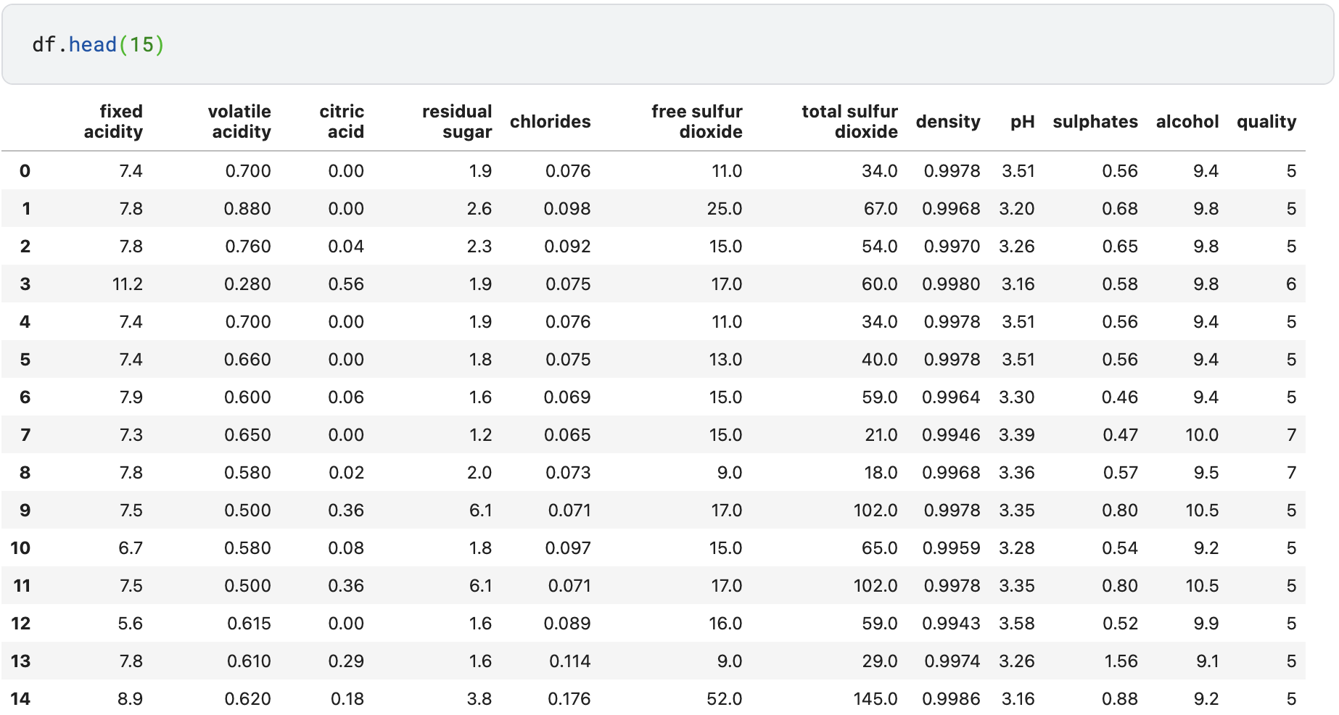
Dataset Details

Slide 6
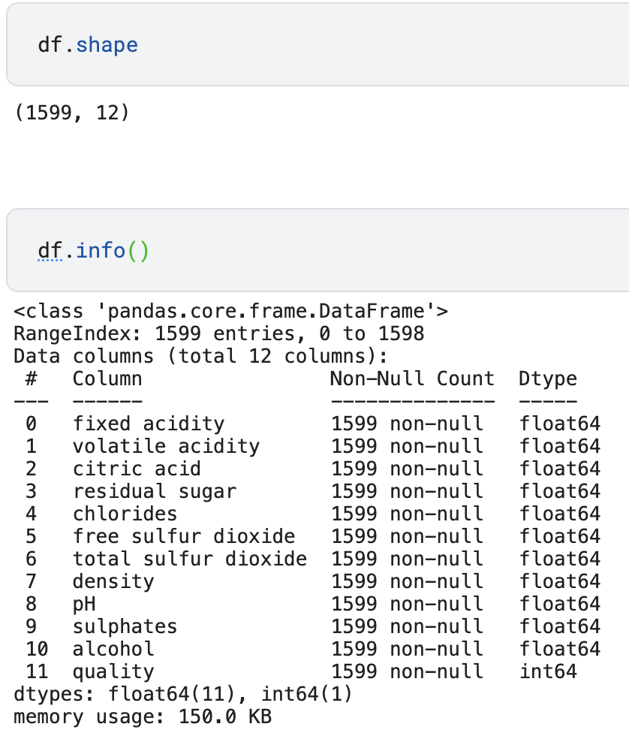
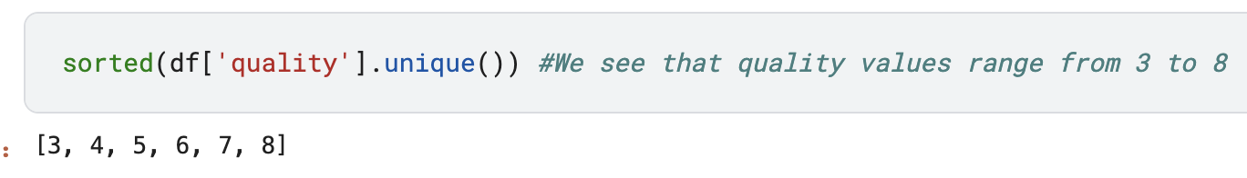
Dataset Details (cont.)
Top-left:
Shape of the data set (12 columns and ~1600 rows)
Top-right
Sorted unique values of wine quality
We can see that the dataset only contains quality values from 3 to 8
Bottom-left:
11 input values are float variables, and output is integer value

Slide 7
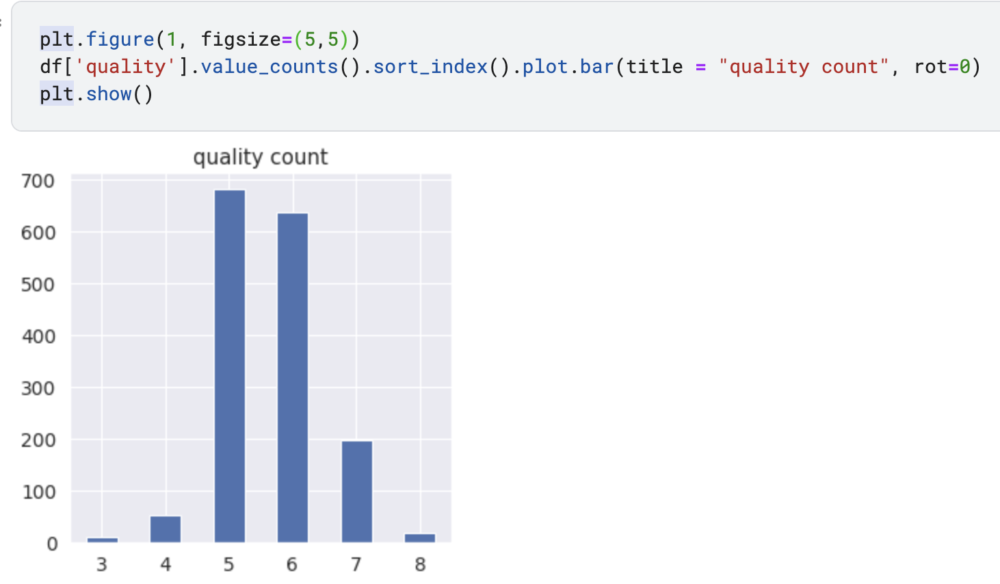
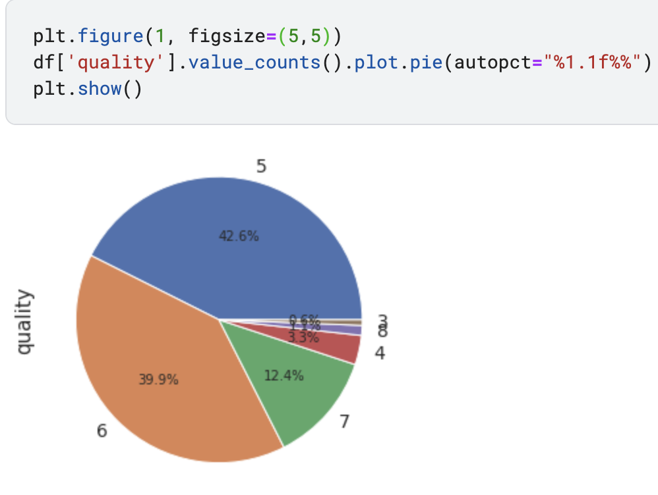
Dataset Details (cont.)
Bar graph and Pie Graph of the distribution of wine quality scores
Average scores (5/6) are far more represented than low/high scores

Slide 8
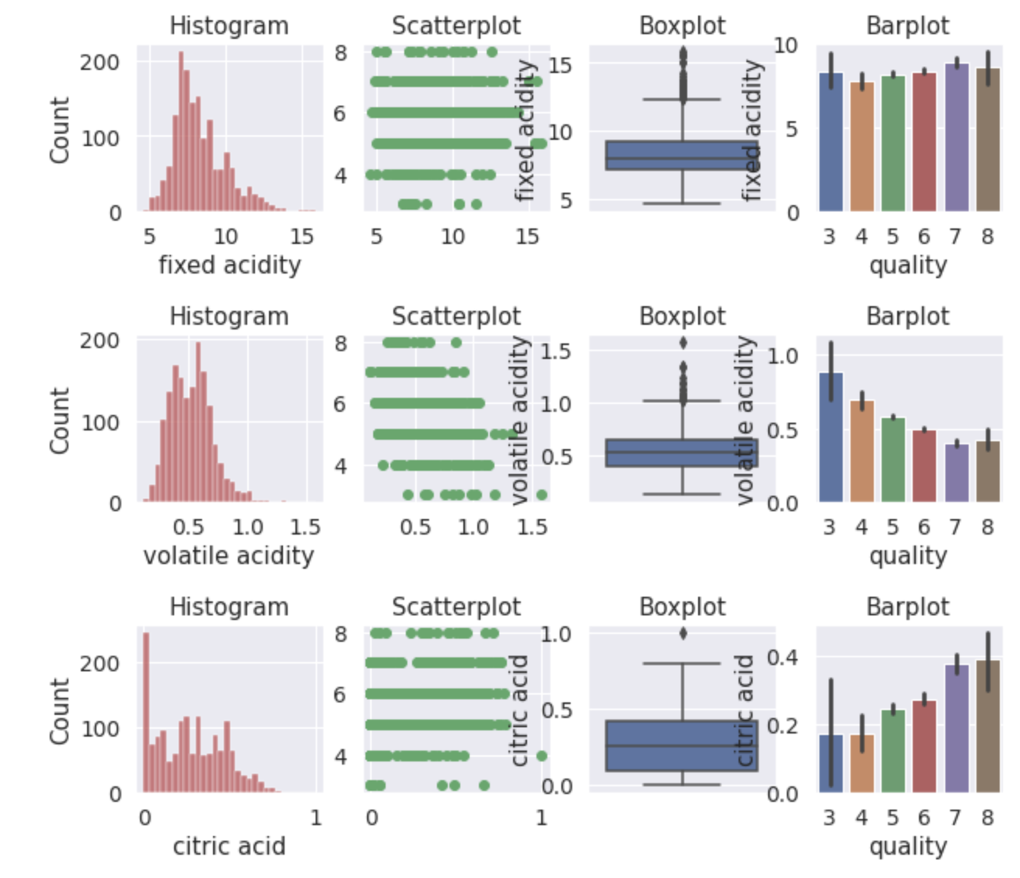
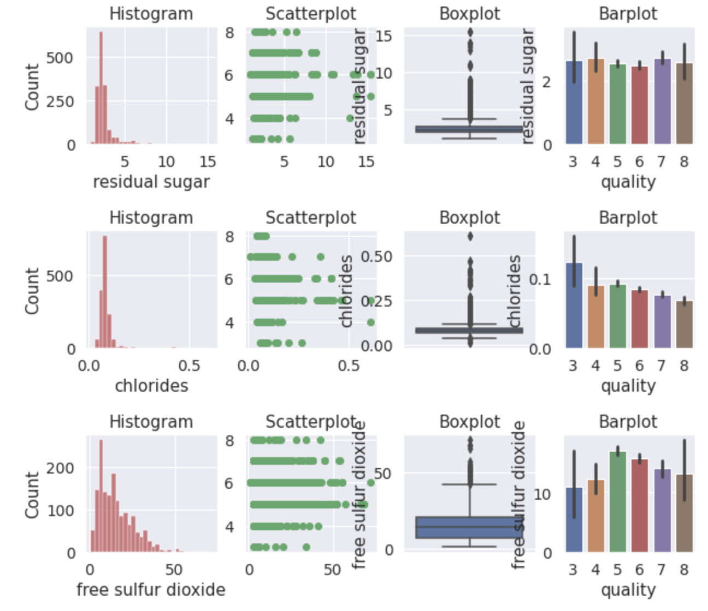
Diagnostic Plots

Slide 9
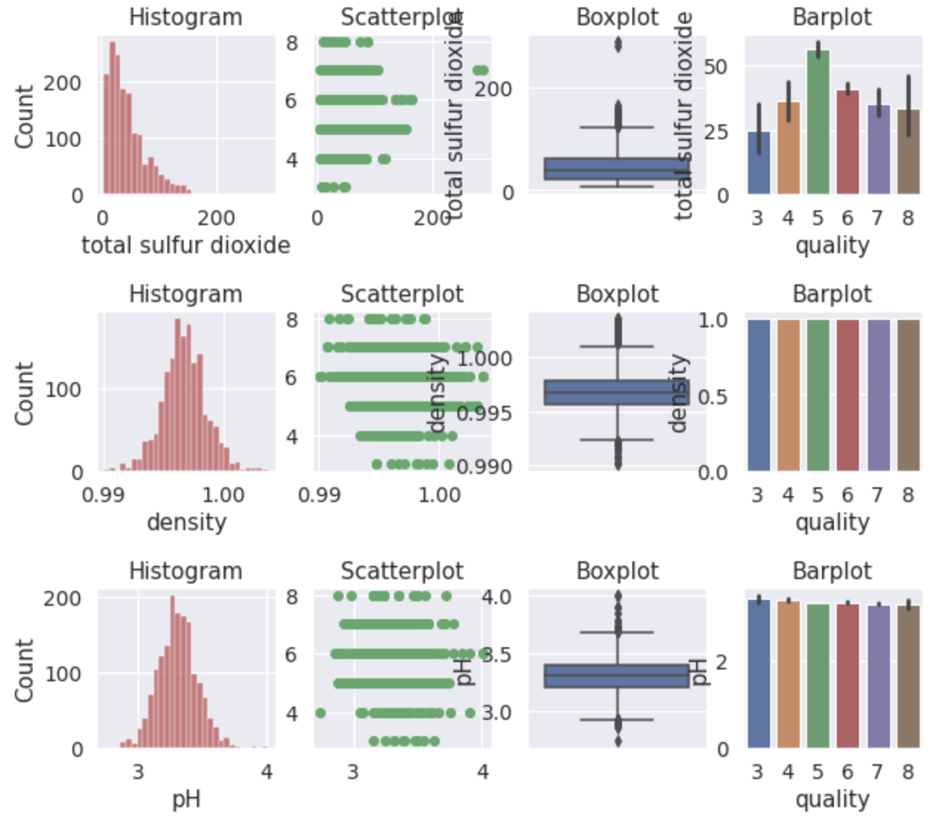
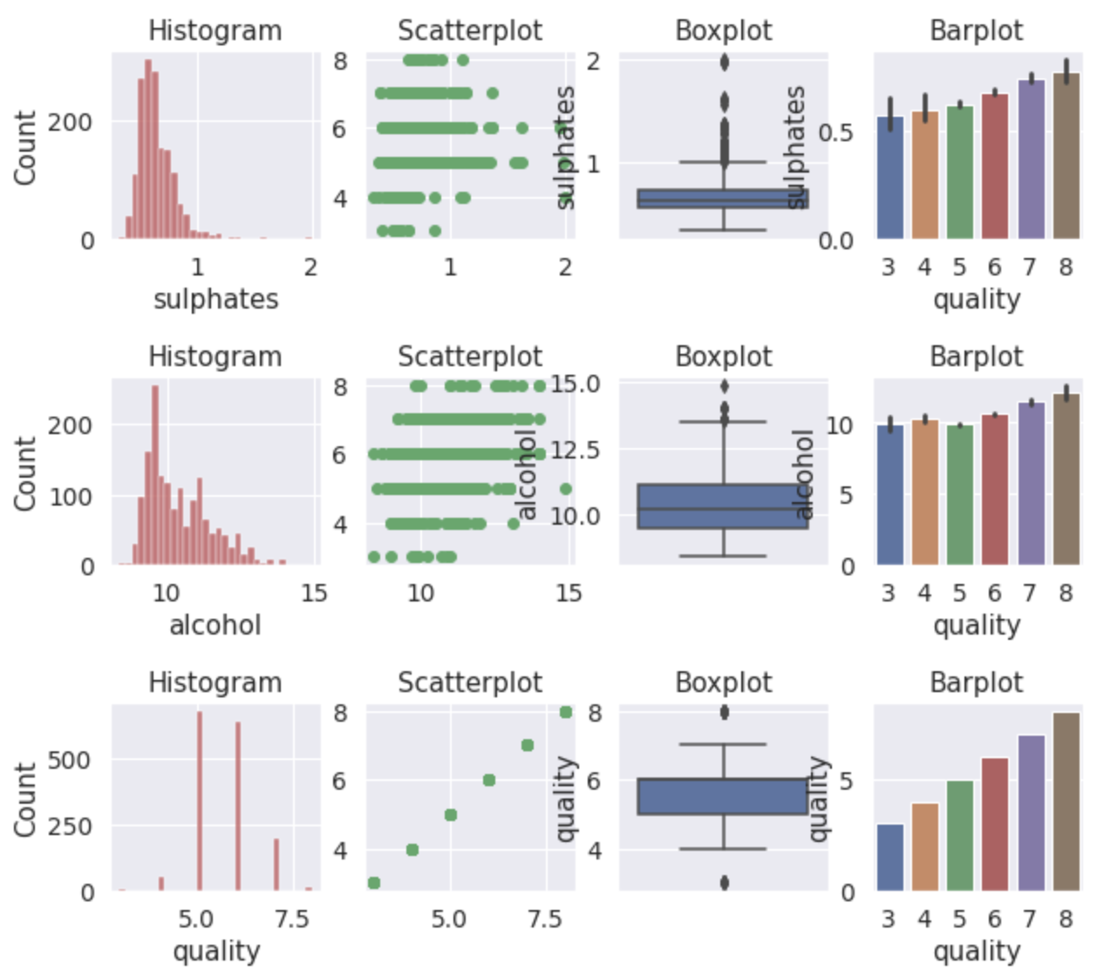
Diagnostic Plots (cont.)

Slide 10
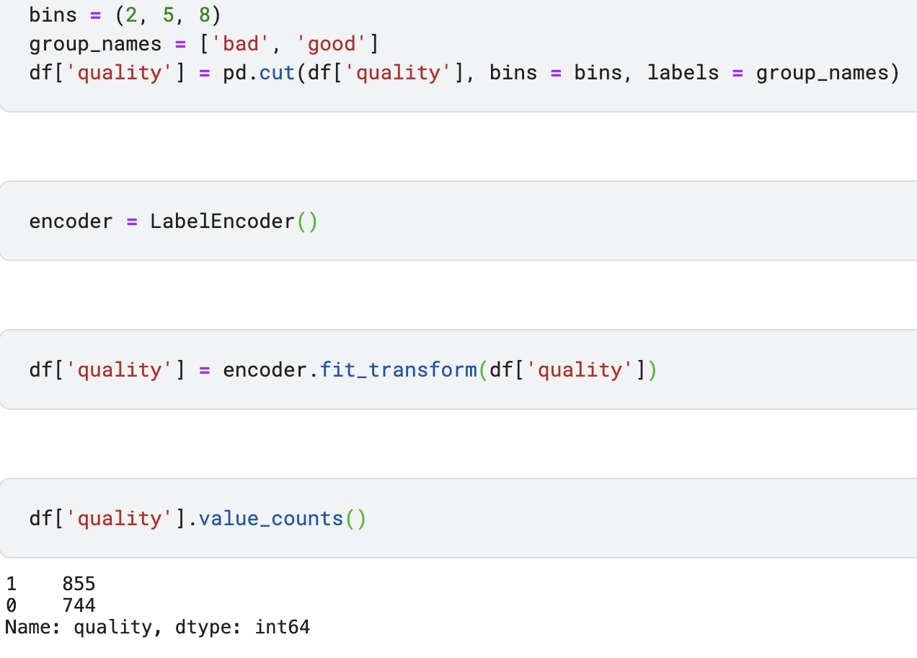
Binary Classification Threshold
Divide the dataset into binary classes of good/bad
The value chosen for the threshold was 5 to create a balance between the two classes
We check the value counts after applying the transform to check the new quality count values

Slide 11
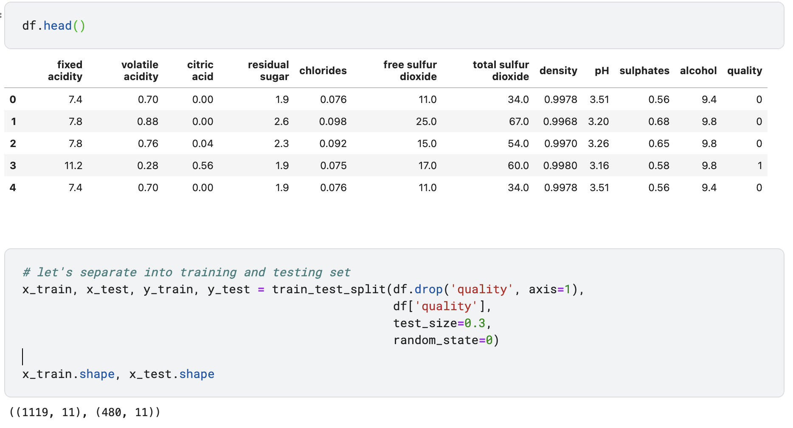
Binary Classification Threshold (cont.)
When checking the dataset again, we can see the quality values are now either 1 or 0
Then divide the dataset into test/train values (30/70)
We then check the shape of the new datasets

Slide 12
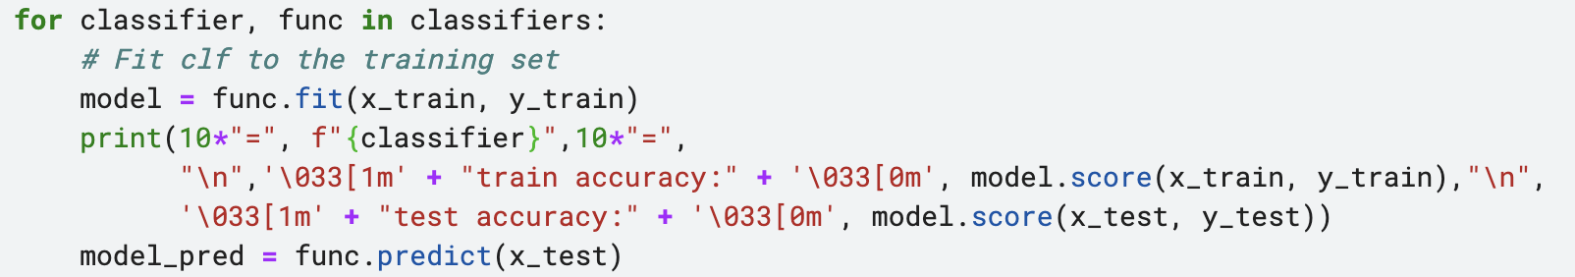
Classifiers
We use 10 different classifiers and then compare their accuracy on the training set, the test set, their F-score, their respective confusion matrices and ROC curves
Classifiers used are:
Logistic Regression
Linear Discriminant Analysis
Decision Tree
Random Forest
Bagging
Gradient Boosting
Ada Boost
XGB
Extra Trees
Voting Classifier

Slide 13
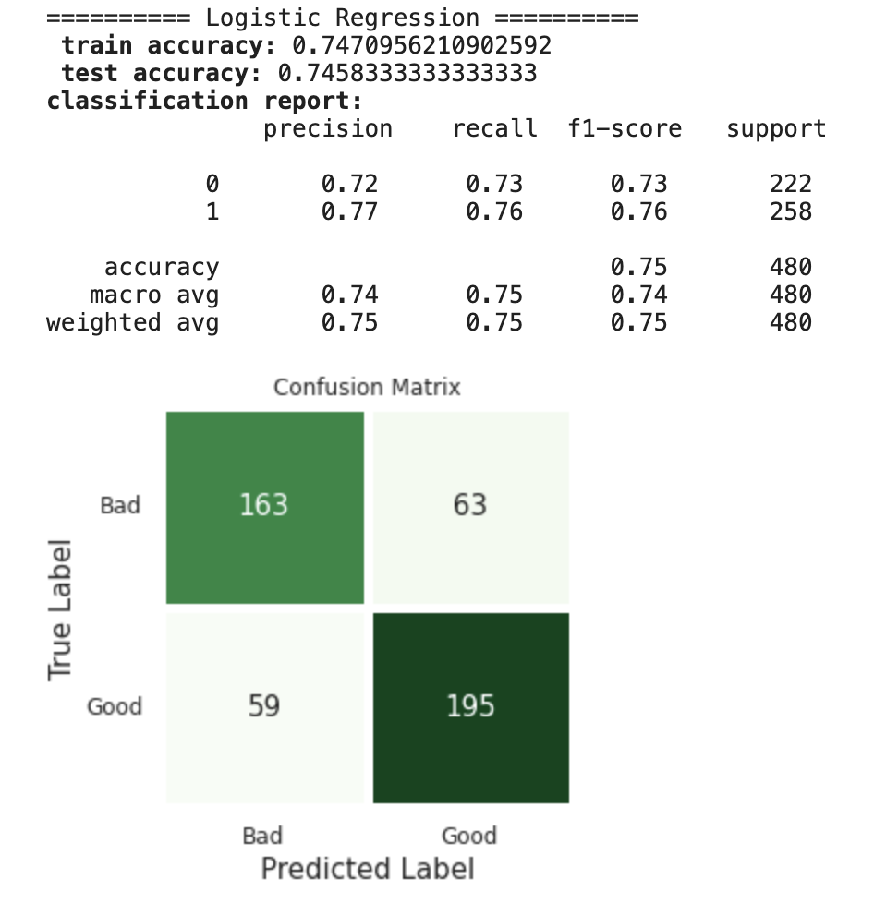
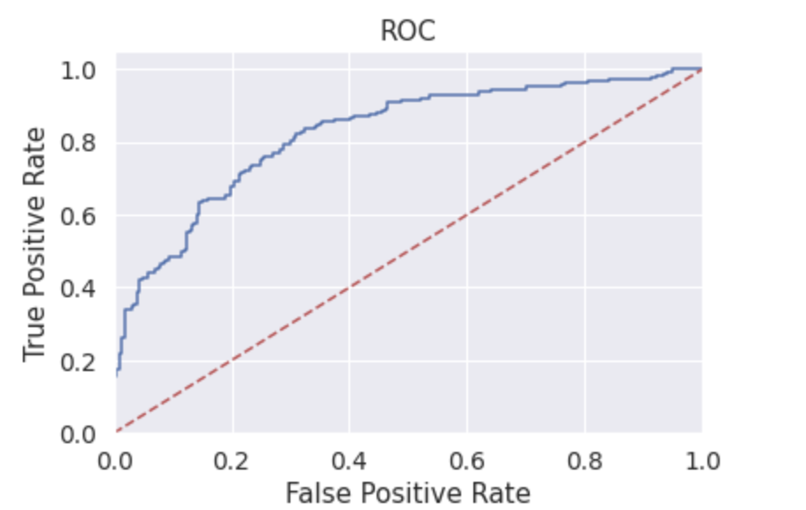
Result Overview

Slide 14

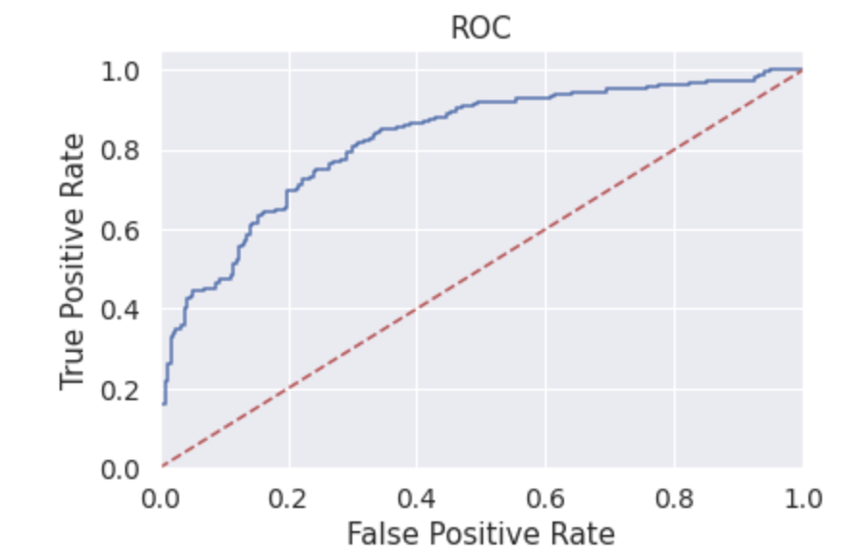
Result Overview (cont.)

Slide 15
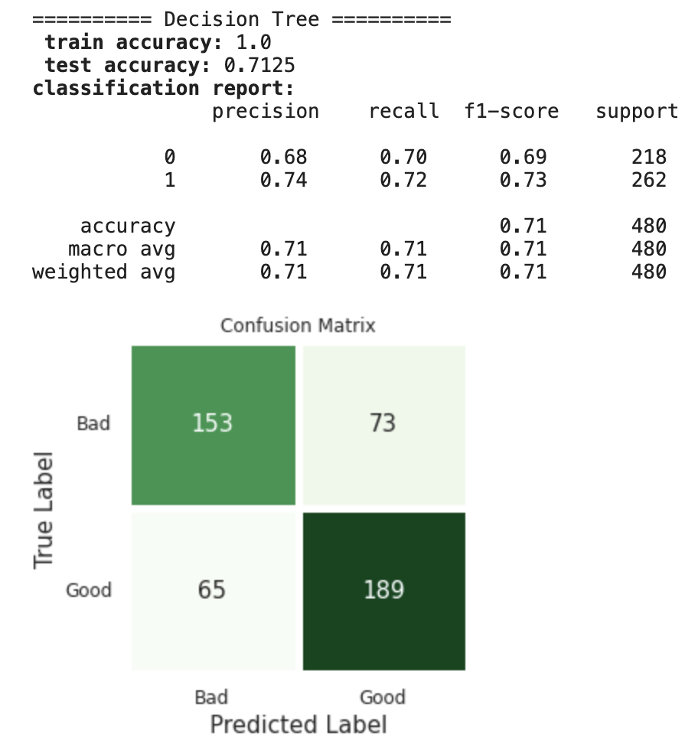
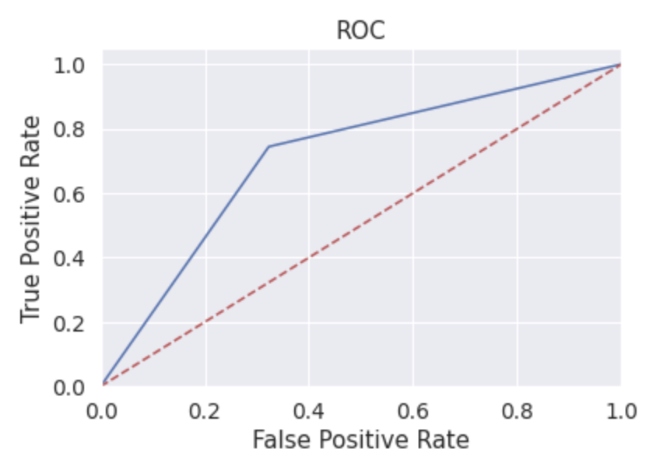
Result Overview (cont.)

Slide 16
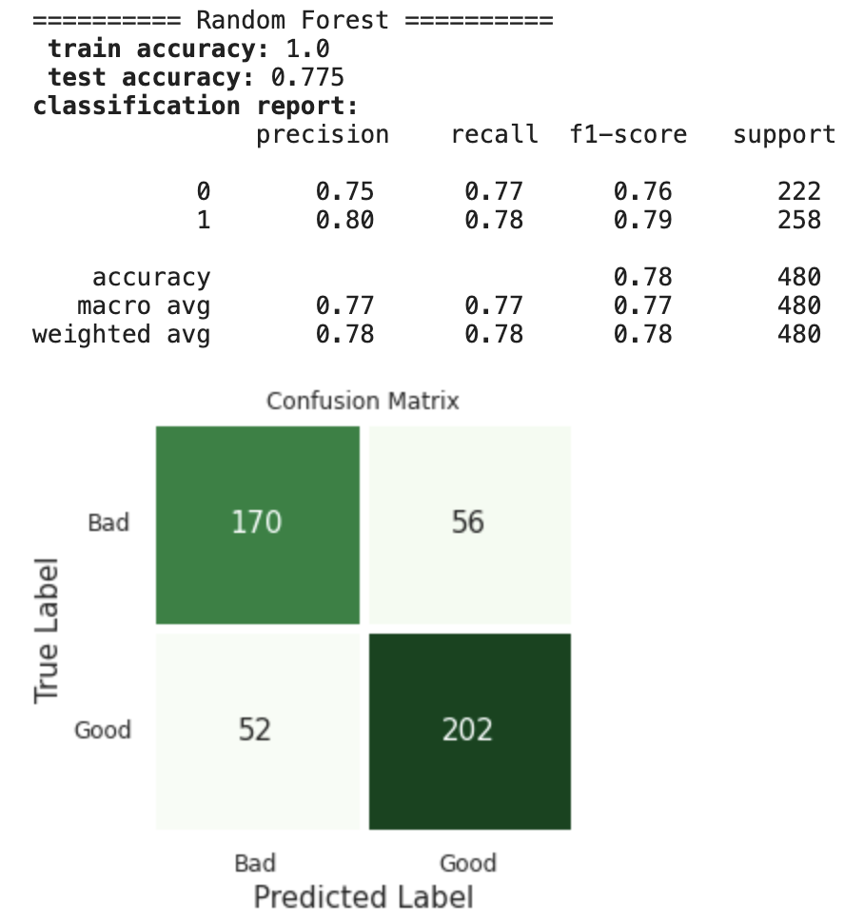
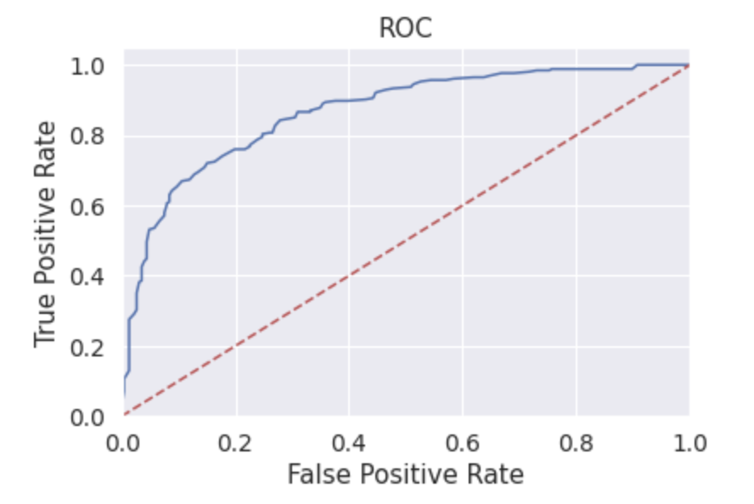
Result Overview (cont.)

Slide 17

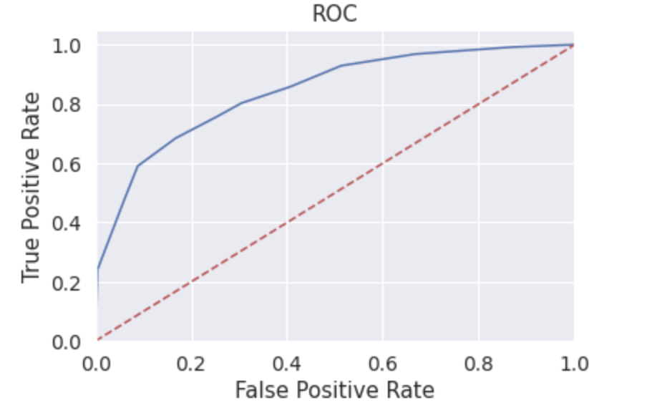
Result Overview (cont.)

Slide 18

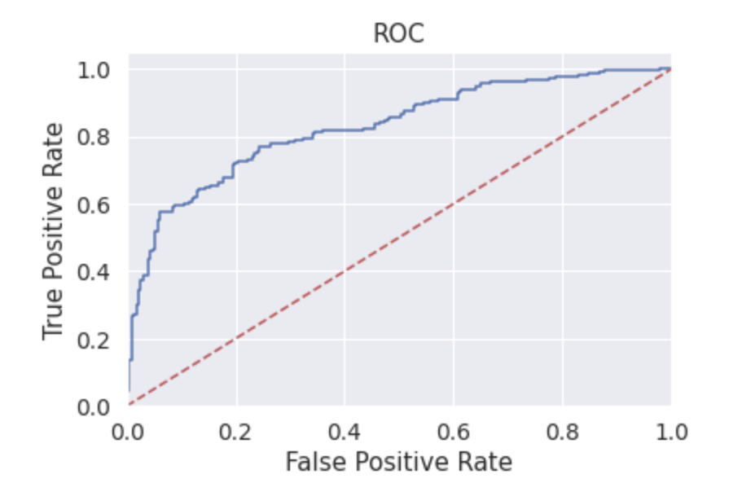
Result Overview (cont.)

Slide 19

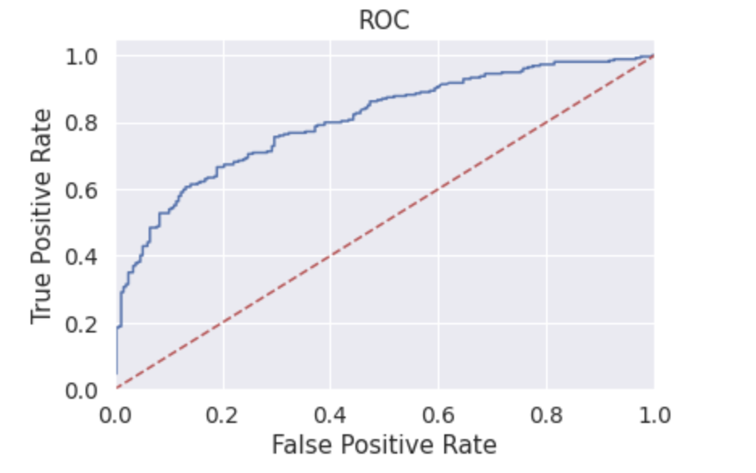
Result Overview (cont.)

Slide 20
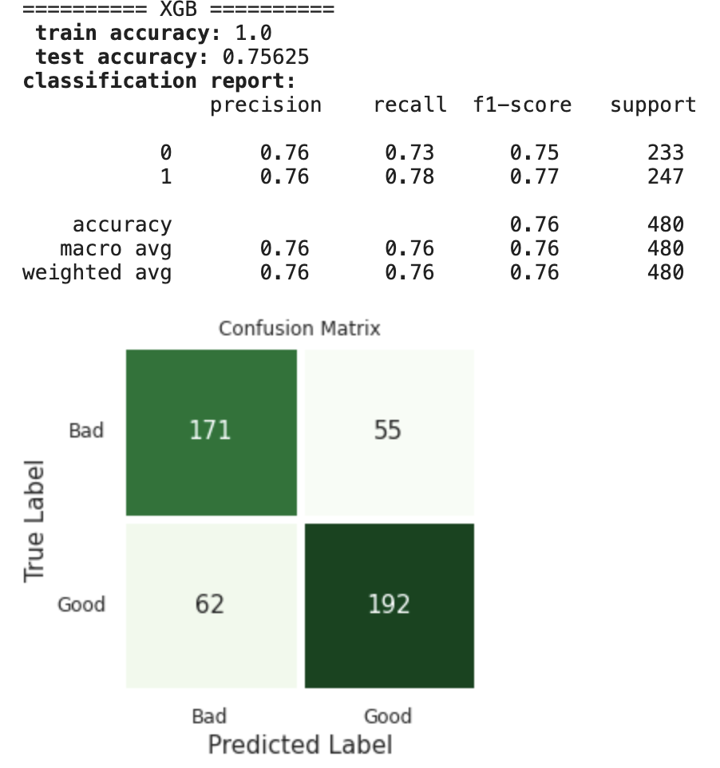
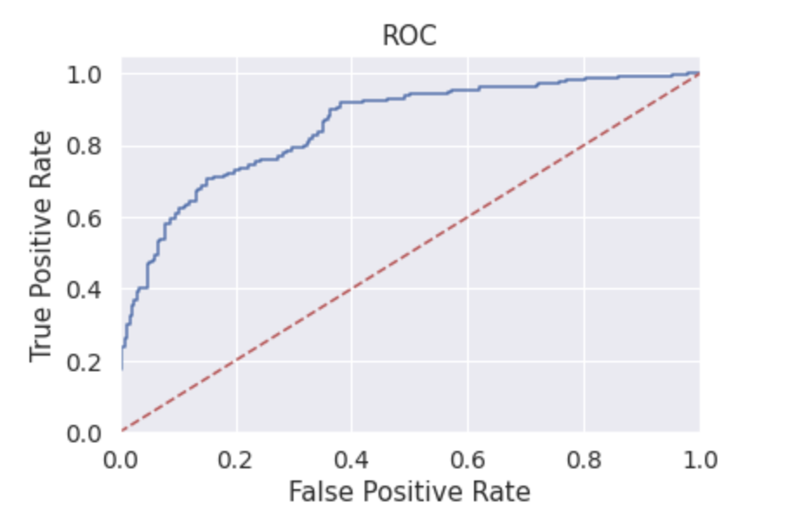
Result Overview (cont.)

Slide 21

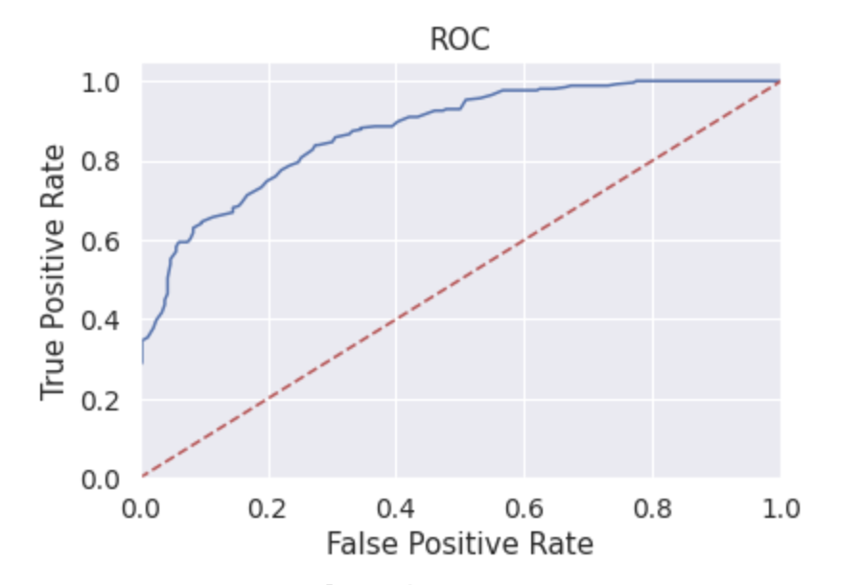
Result Overview (cont.)

Slide 22
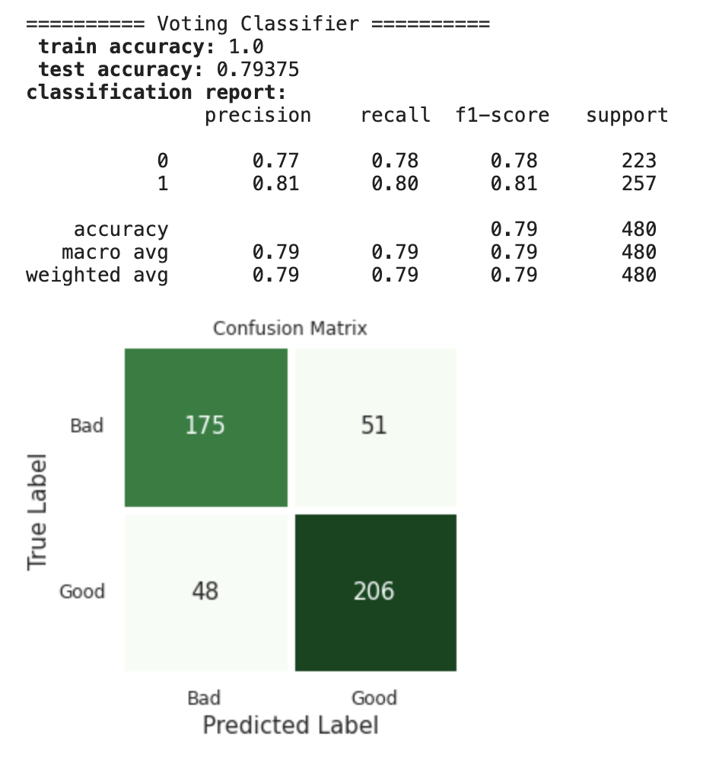
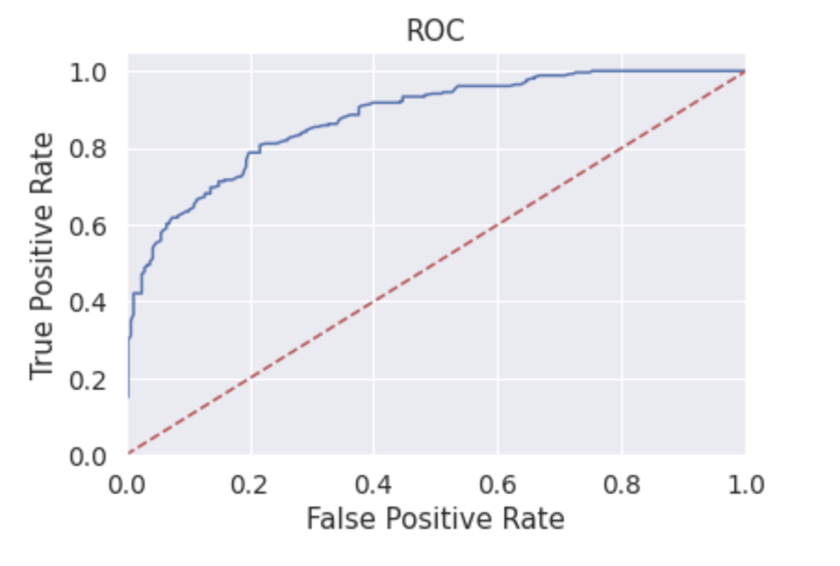
Result Overview (cont.)

Slide 23
Classifier Comparison
The most accurate classifier was found to be the Voting Classifier with Extra Trees being a close second
More values are skewed towards 1 rather than 0 (slightly imbalance in the dataset)
We can see this by the classifiers accuracy, as the former has a slightly better F-score across all classifiers
Some classifiers have return a better precision precision rather than recall, but in all cases, both are quite similar in value

